Slide 1

DriverPass System Analysis
Sulochana Pradhan
Notes:
Welcome to the system design and analysis presentation of the DriverPass application. My name is Sulochana Pradhan, and I am excited to present the system analysis and key design areas.

Slide 2

System Requirements
Functional Requirements
User registration, login, and password reset.
Three training packages choice.
Ability to schedule/modify/cancel training appointments.
Ability to view progress.
Report generation and offline access.
Non-Functional Requirements
Any operating system with browser support.
The system should be able to auto-scale as needed.
Secure system with proper security measures.
Notes:
The core idea behind the DriverPass system is to allow the student to train so that they can pass the DMV exam. As the system has the concept of a user, it needs common user login functionalities. It includes registration, login, and password reset. The password reset can be done by the user or other privileged users. The student will be able to schedule, modify, and cancel the training appointments. They can also call secretaries of the DriverPass to do so. Moreover, the system will have a dashboard where the student will be able to see their progress. One major functionality of the DriverPass system is the administrator can view all the activities related to scheduling and able to access them even without an internet connection.
As the DriverPass system is a web-based application, it will be compatible with any operating system with modern web browsers. This includes phones, tablets, and computers. We do not know the number of users who will be using our system. We want the DriverPass system to use the cloud features as much as possible. For the variable user load, we will auto-scale the system. That means it will handle a large number of users at the same time without any downtime. We will also use firewalls, password encryption, and different other security measures to make sure our user data is secure and safe.

Slide 3
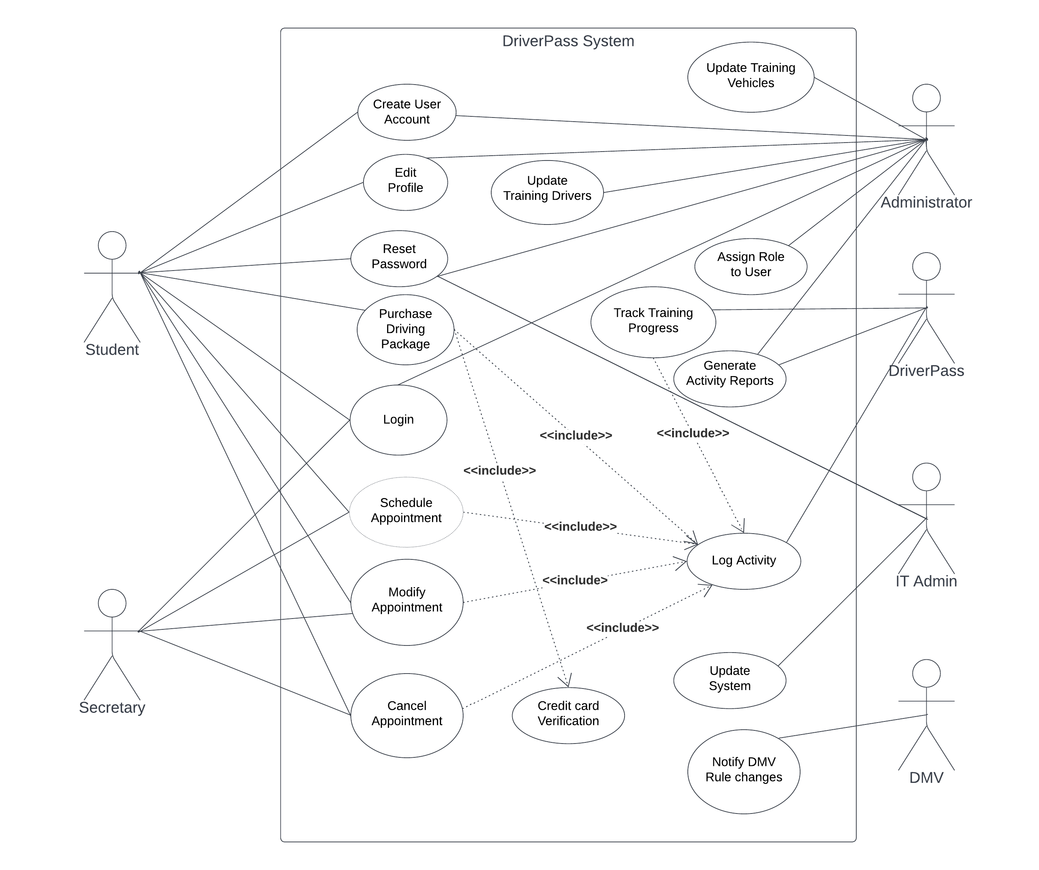
Use Case Diagram
Notes:
This is the use case diagram of the DriverPass system. The use case means any functionality that the user can do in the system. We can see there are quite a big number of functionalities each represented by an elliptical shape. Similarly, we can see there are 6 different actors. Each actor can perform a certain set of functionalities. In the DriverPass system, the student can do self-registration, log in, schedule training, etc. Secretary can also help the student to schedule an appointment. Each activity related to scheduling, tracking training progress, and purchases get logged into the system. It is done by the DriverPass system itself. We can see administrators can do a lot of administrative tasks such as updating training vehicles, resetting passwords, assigning roles, and generating activity reports. DriverPass system also has an IT admin who helps to reset the password and update the DriverPass system as needed. Finally, the DriverPass system gets a notification from the DMV whenever there are changes in rules and laws so that we can immediately update the training program as needed.

Slide 4
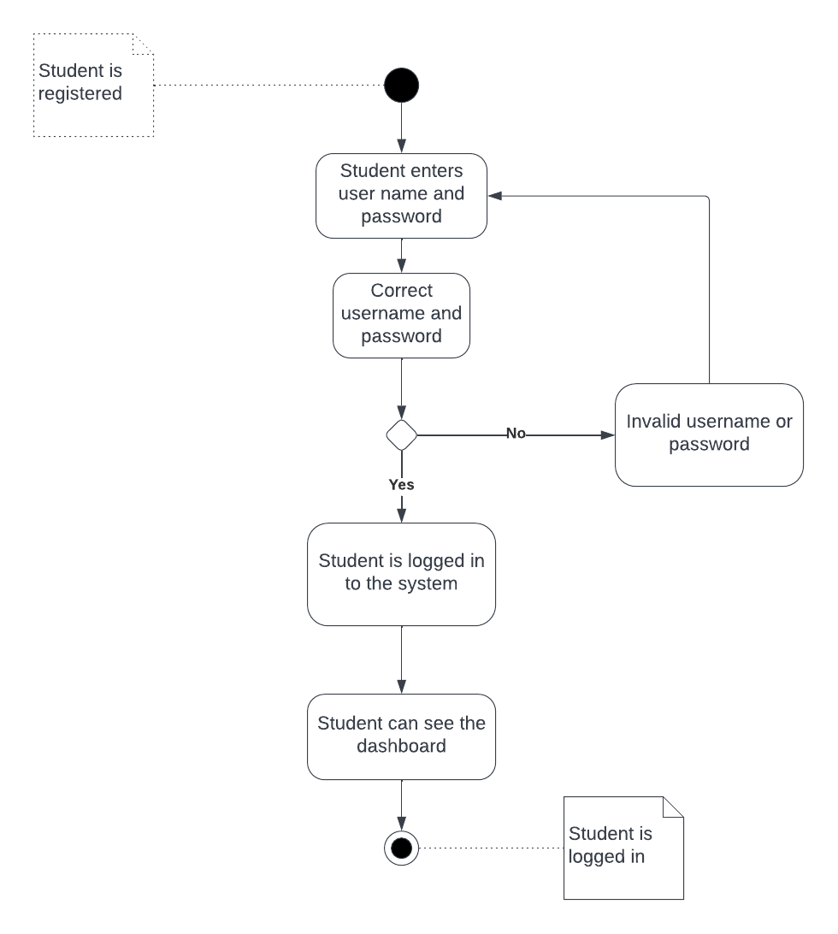
Activity Diagram
Notes:
This is an example of an activity of the DriverPass. This activity diagram represents the login process. As we can see for the login, the user needs to be registered first. First, the user enters the username and password and submits the form. If both username and password combination is valid, then the system logs in the user to the system and they can see their dashboard. If the provided username or password is invalid, then the system allows the user to reenter their username and password. The system provides a simple yet secure login mechanism. The DriverPass will take necessary security measures to make sure the user information and password are not visible to hackers.

Slide 5
Security
Only valid user with username and password can login.
Secure data exchange between client and server.
Account lock after more than 5 invalid login attempt.
VPC database with encryption enabled.
Notes:
DriverPass understands the importance of data security. As we are storing lots of user information including address and credit card, we furthermore need to make sure the system is secure. For that, we will allow only a secure connection between the customer and our server. Customers will see HTTPS whenever they are on our website. There is no anonymous access to certain areas of the web application. More importantly, username and password are both case sensitive. To prevent the brute force approach of login, we will be tracking the user IP address and lock the user account after 5 unsuccessful login attempts. Users can contact our customer service to unlock their accounts. To further enhance the security we will be using human verification so that we can prevent the bot from attempting to be in our system. To make sure the system is secure enough, we are hosting the database inside the private connection network so that only the DriverPass application will be able to talk with it. Furthermore, we will implement the necessary encryption to make the database more secure.

Slide 6
System Limitations
Internet based application.
DMV rules update.
Limited number of vehicles.
Notes:
DriverPass is an internet-based application. So, the user must have a proper internet connection to use the system. Moreover, the speed limitation comes from the client’s internet speed, and they may face unpleasant experiences while trying to watch the training video. Even with instant notification about the DMV rule changes, it will take some time for DriverPass to update the training data accordingly. This can cause outdated training data for some time.
On a hectic day, there can be long waiting time for the in-road training with 10 vehicles, which can negatively affect the DriverPass reputation.

